Slide 1
Human Relationality and Christian Morality
Record the following notes under the "Concluding Notes" section of your student notes handout.

Slide 2


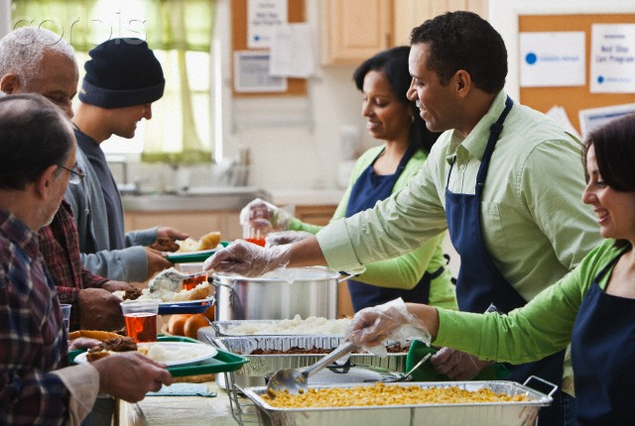
Humans are relational beings
created for relationship with God and each other
need each other

Slide 3
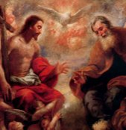

Most fully ourselves when we mirror the Trinity and live in relationships of love

Slide 4
Sin and Christian Morality
Sin destroys relationship- causes us to turn in on ourselves
Christian morality
NOT an arbitrary list of things the Church says you can/can’t do
Seeks to guide us so that we can live in proper relationship with God and each other

Slide 5
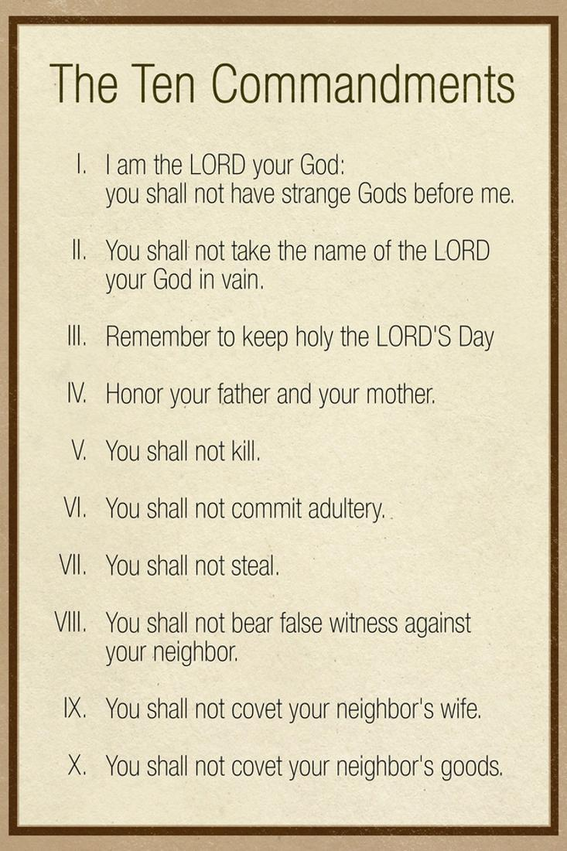
Commandments 1-3- Protect relationship with God
Commandments 4-10- Protect relationship with other humans
Notes:
To conclude, emphasize how all the Church's moral teachings aim to protect/nourish our relationships with God and others. By doing so, we fulfill our relational nature and become more fully ourselves.

Slide 6
Psalm 119:33-35
Teach me, O Lord, the way of your statutes, and I will observe it to the end. Give me understanding, that I may keep your law and observe it with my whole heart. Lead me in the path of your commandments, for I delight in it.
Notes:
Have a student volunteer to read. Then ask the students if they find the psalmists attitude surprising. Why or why not?

Slide 7
What do you think?
Why do you think the psalmist has such a positive attitude towards the commandments?
Following the commandments is hard! How can we view them in a positive light (like the psalmist) rather than as a burden?

